Slide 1
RL_Project_Presentation 2024/12/06

Slide 2
Group Member
陳昕佑 61375017H Vincent
李柏叡 61375079H Bread
林聖倫 61375082H Liam

Slide 3
Project Definition
Topic
Frozen Lake Improvement (with DQL)
Objective
Adjust the environment, state space and action space, also fine tuning the reward function

Slide 4
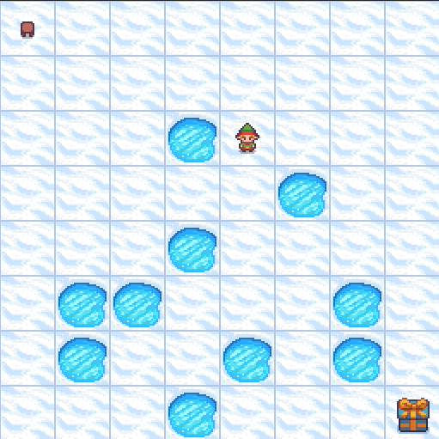
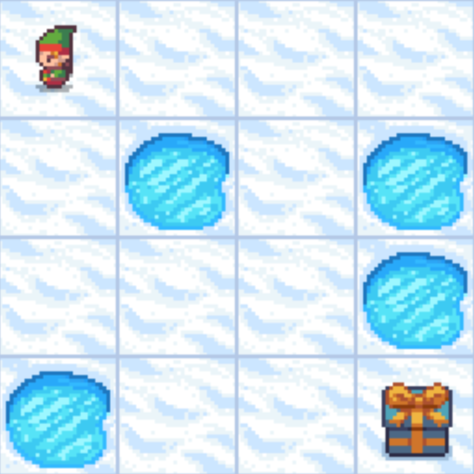
Environment
Notes:
Statistic-based model : 基於統計的模型
Gaussian Regression Model : 高斯回歸模型
Satisfactory : 滿意的

Slide 5
Environment
“S” for Start tile
“G” for Goal tile
“F” for frozen tile
“H” for a tile with a hole
"4x4":[
"SFFF",
"FHFH",
"FFFH",
"HFFG"
]
"8x8": [
"SFFFFFFF",
"FFFFFFFF",
"FFFHFFFF",
"FFFFFHFF",
"FFFHFFFF",
"FHHFFFHF",
"FHFFHFHF",
"FFFHFFFG",
]
Notes:
Statistic-based model : 基於統計的模型
Gaussian Regression Model : 高斯回歸模型
Satisfactory : 滿意的

Slide 6
Action Space
Move left
Move down
Move right
Move up
Move upper-left
Move lower-left
Move upper-right
Move lower-right

Slide 7
Reward
Uncertainty-Aware Human Motion Prediction
Reach goal: +5
Reach gift: +1
Reach hole: 0
Reach frozen: 0
Notes:
Phi 1 and Phi 2 are two bone vectors of human upper-arm and forearm.
The position of arm joints and human arm occupied(佔據) area in the workspace can be reconstructed using x and anthropometric parameters Ph, which contain(包含) the average bone length and radius of the human arm for each segment.

Slide 8
Thanks
Notes:
實驗驗證

